Slide 1
Parallel Sorting Algorithms
Cheng-Hung Lin

Slide 2
Sorting Algorithms
Sorting
Re-arranging a list of numbers into increasing (strictly non-decreasing) order
One of the most common and critical operation in large data processing

Slide 3
Potential Speedup
O(nlogn) optimal sequential sorting algorithm
n is the number of elements
Best we can expect based upon a sequential sorting algorithm using n processors is:
Has been obtained but the constant hidden in the order notation extremely large

Slide 4
Odd-Even with transposition (1/2)
It is a variant of the bubble-sort
Operates in two alternate phases:
Phase-even:
even processes exchange values with right neighbors.
Phase-odd:
odd processes exchange values with right neighbors.

Slide 5
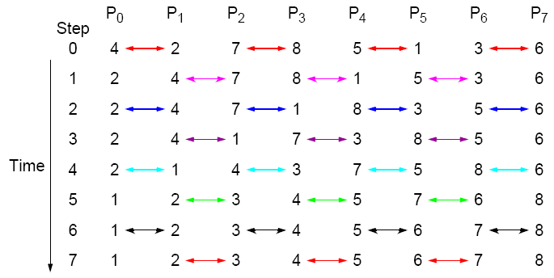
Odd-Even Transposition Sort - example
Parallel time complexity: T_{par} = O(n) (for P=n)

Slide 6
Example
void serial_odd_even_sort(int *p, int size) {
int swapped, i;
int temp;
do {
swapped = 0;
for(i = 1; i < size-1; i += 2) { //odd
if(p[i] > p[i+1]) {
temp = p[i]; p[i] = p[i+1]; p[i+1] = temp;
swapped = 1;
}
}
for(i = 0; i < size-1; i += 2) { //even
if(p[i] > p[i+1]) {
temp = p[i]; p[i] = p[i+1]; p[i+1] = temp;
swapped = 1;
}
}
} while(swapped);
}
#include <stdio.h>
#include <stdlib.h>
void serial_odd_even_sort(int *p, int size);
int main(){
int s[10]={10, 9, 8, 7, 6, 5, 4, 3, 2, 1};
int i;
serial_odd_even_sort(s, 10);
for(i=0; i<10; i++){
printf("%d ", s[i]);
}
printf("\n");
}

Slide 7
Odd-Even Transposition Sort – Example (N >> P)
Each PE gets n/p numbers. First, PEs sort n/p locally, then they run
odd-even trans. algorithm each time doing a merge-split for 2n/p numbers.
P₀ P₁ P₂ P₃
13 7 12 8 5 4 6 1 3 9 2 10
Local sort
7 12 13 4 5 8 1 3 6 2 9 10
O-E
4 5 7 8 12 13 1 2 3 6 9 10
E-O
4 5 7 1 2 3 8 12 13 6 9 10
O-E
1 2 3 4 5 7 6 8 9 10 12 13
E-O
SORTED: 1 2 3 4 5 6 7 8 9 10 12 13
Time complexity: T_{par} = (Local Sort) + (p merge-splits) +(p exchanges)
T_{par} = (n/p)log(n/p) + p*(n/p) + p*(n/p) = (n/p)log(n/p) + 2n

Slide 8



Mergesort (1/2)
Example of a divide-and-conquer algorithm
Sorting method to sort a vector; first subdivides it in two parts, applies again the same method to each part and when they are both sorted (2 sorted vectors/lists) with m and n elements, they are merged to produce a sorted vector that contains m + n elements of the initial vector
The average complexidade is O(n log n).

Slide 9
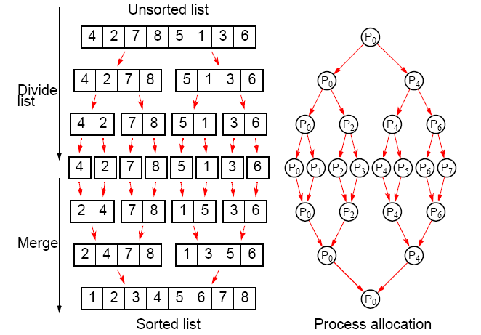



Parallelizing Mergesort
$$T_{comm}=O\left(2(\frac{n}{2}+\frac{n}{4}+…+1)\right)=O(n)$$
Divide & Conquer
Sequential: O(𝑛 log 𝑛)
Parallel: 𝑂(𝑛)
$$T_{comp}=O\left(n+\frac{n}{2}+\frac{n}{4}+…+2)\right)=O(n)$$
$$A=πr^{2}$$

Slide 10
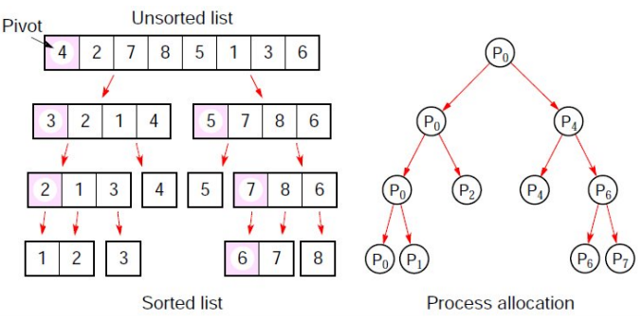
Parallel Quicksort
Most popular sequential sorting algorithm
Parallel: Iteratively pick pivot and partition numbers
Sequential: O(𝑛 log 𝑛)
Parallel: 𝑂(𝑛)
Still best choose in parallel?

Slide 11
Difficulties with the allocation of processes organized in a tree
The initial division starts with just one process, which is limiting.
The search tree of quicksort is not, in general, balanced.
Selecting the pivot is very important for efficiency

Slide 12
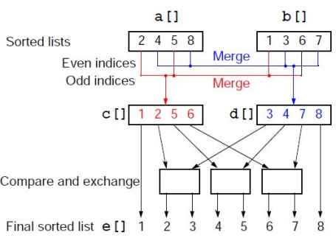
Odd-Even mergesort
complexity: O(log ²n)
merging the two lists a₁, a₂, . . . , a_{n} and b₁, b₂, . . . , b_{n}, where n is a power of 2.

Slide 13
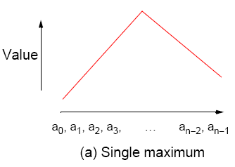
Bitonic Mergesort
A parallel sorting algorithm based on bitonic sequence
Remove the O(N) bottleneck for merging
Monotonic sequence:
A sequence of increasing numbers
<1, 2, 3, 4, 5, 7, 8, 9>
Bitonic sequence:
Two sequences, one increasing and one decreasing
<3, 5, 8, 9, 7, 4, 2, 1, >

Slide 14
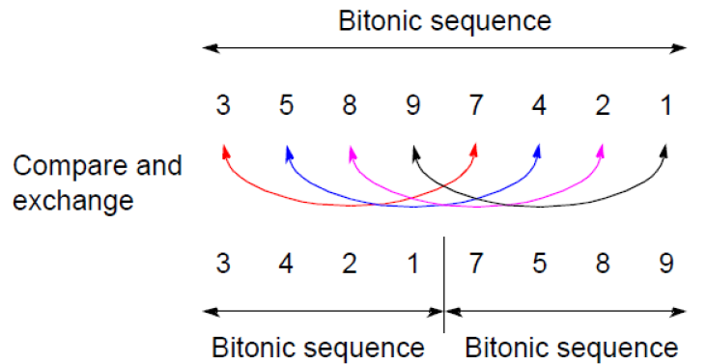
Characteristic of Botonic Sequence
If we perform a compare-and-exchange operation on 𝑎_{𝑖} with 𝑎_{𝑖+𝑛/2} for all 𝑖
Get TWO bitonic sequences
The numbers in one sequence are all less than the numbers in the other sequence
Example: <3,5,8,9,7,4,2,1>

Slide 15
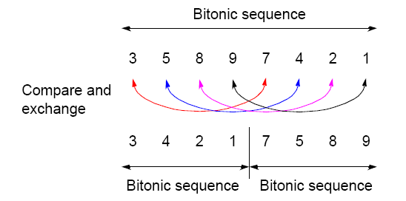
Binary Split
Divide the bitonic list into two equal halves.
Compare-Exchange each item on the first half with the corresponding item in the second half.
Result:
Two bitonic sequences where the numbers in one sequence are all less than the numbers in the other sequence.

Slide 16
Repeated application of binary split
Bitonic list:
24 20 15 9 4 2 5 8 | 10 11 12 13 22 30 32 45
Result after Binary-split:
10 11 12 9 4 2 5 8 | 24 20 15 13 22 30 32 45
If you keep applying the BINARY-SPLIT to each half repeatedly, you
will get a SORTED LIST !
10 11 12 9 . 4 2 5 8 | 24 20 15 13 . 22 30 32 45
4 2 . 5 8 10 11 . 12 9 | 22 20 . 15 13 24 30 . 32 45
4 . 2 5 . 8 10 . 9 12 .11 15 . 13 22 . 20 24 . 30 32 . 45
2 4 5 8 9 10 11 12 13 15 20 22 24 30 32 45
Q: How many parallel steps does it take to sort ?
A: log n

Slide 17
Sorting an arbitrary sequence
To sort an unordered sequence, sequences are merged into larger bitonic sequences, starting with pairs of adjacent numbers.
By a compare-and-exchange operation, pairs of adjacent numbers formed into increasing sequences and decreasing sequences. Pairs form a bitonic sequence of twice the size of each original sequences.
By repeating this process, bitonic sequences of larger and larger lengths obtained.
In the final step, a single bitonic sequence sorted into a single increasing sequence.

Slide 18
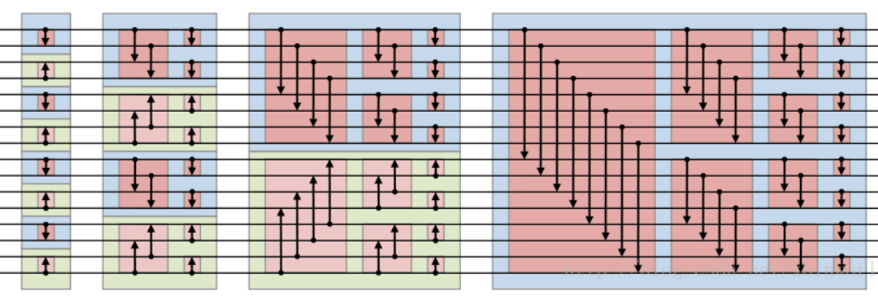
Sorting an arbitrary sequence

Slide 19
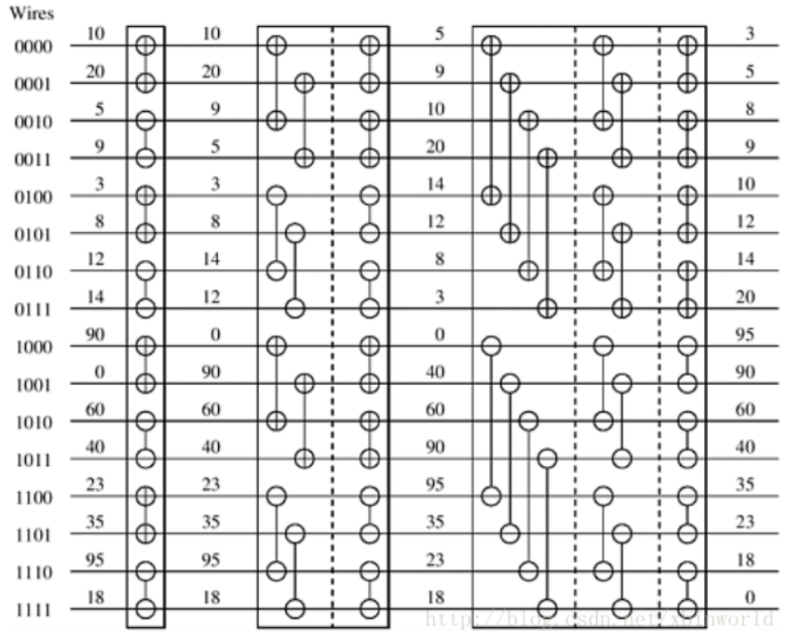
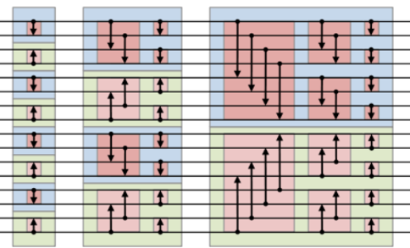
Sorting an arbitrary sequence

Slide 20
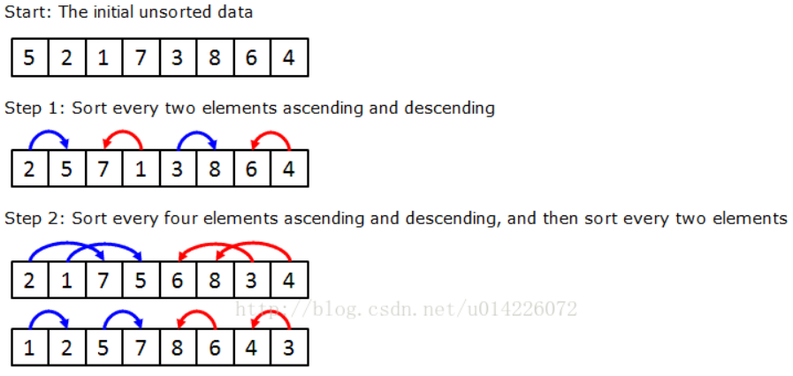
Example of bitonic sorting

Slide 21
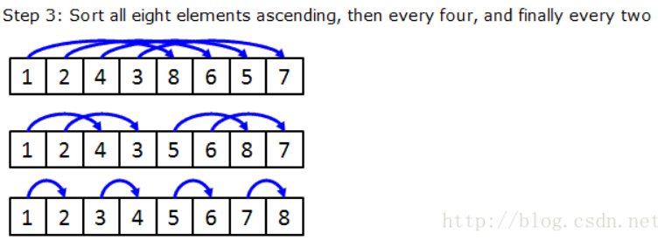
https://quinstonpimenta.medium.com/bitonic-merge-sort-explanation-and-code-tutorial-5688bd3507fb

